Slide 1
PHYS204: The Governing Laws of Physics
Created by: Jeremy Duncan
June 14th 2022

Slide 2
Introduction
In this project I will be demonstrating fundamental concepts of the governing laws of physics by applying technologies from the growing field of Internet of Things (IoT).

Slide 3
Concepts Covered
Section 1: Materials Used
Section 2: Precision of Ultrasonic sensor
Section 3: Gravitational Acceleration
Section 4: Conservation Of Energy
Section 5: Rotational Motion
Section 6: Hall Effect

Slide 4
SECTION 1
Materials Used
In section one of my project, I am:
Showing the IOT devices and materials I will be using.

Slide 5
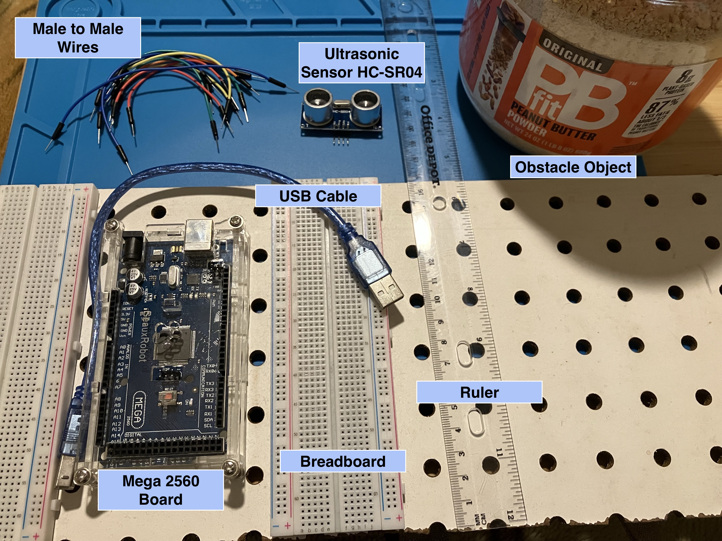
Section 1: Materials Used

Slide 6
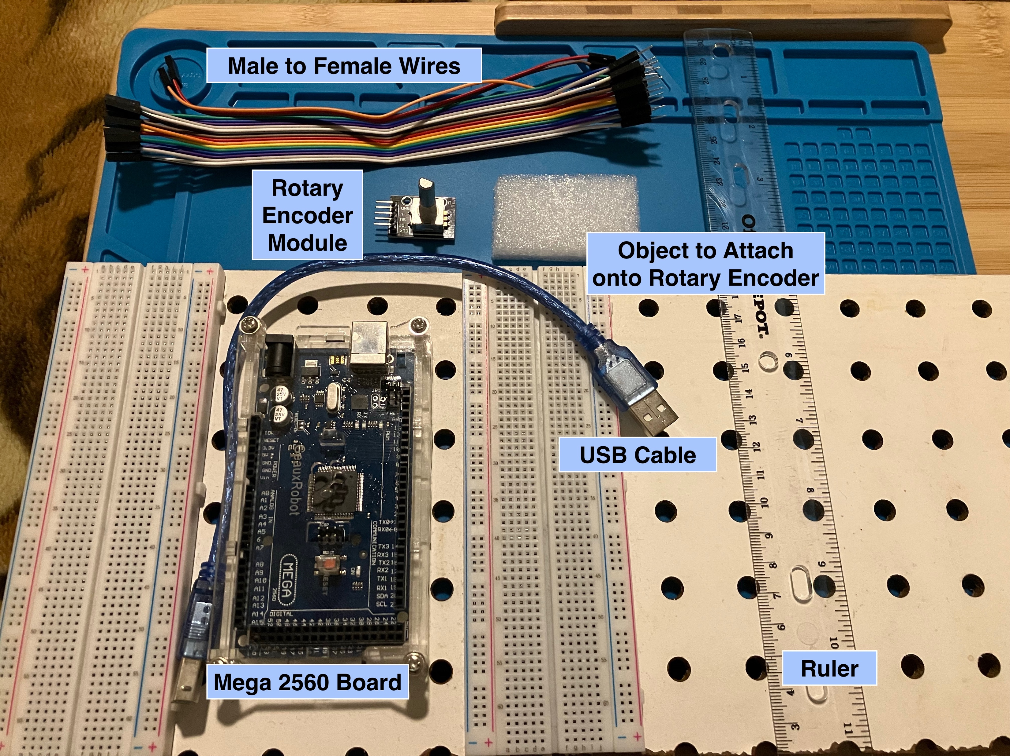
Section 1: Materials Used

Slide 7
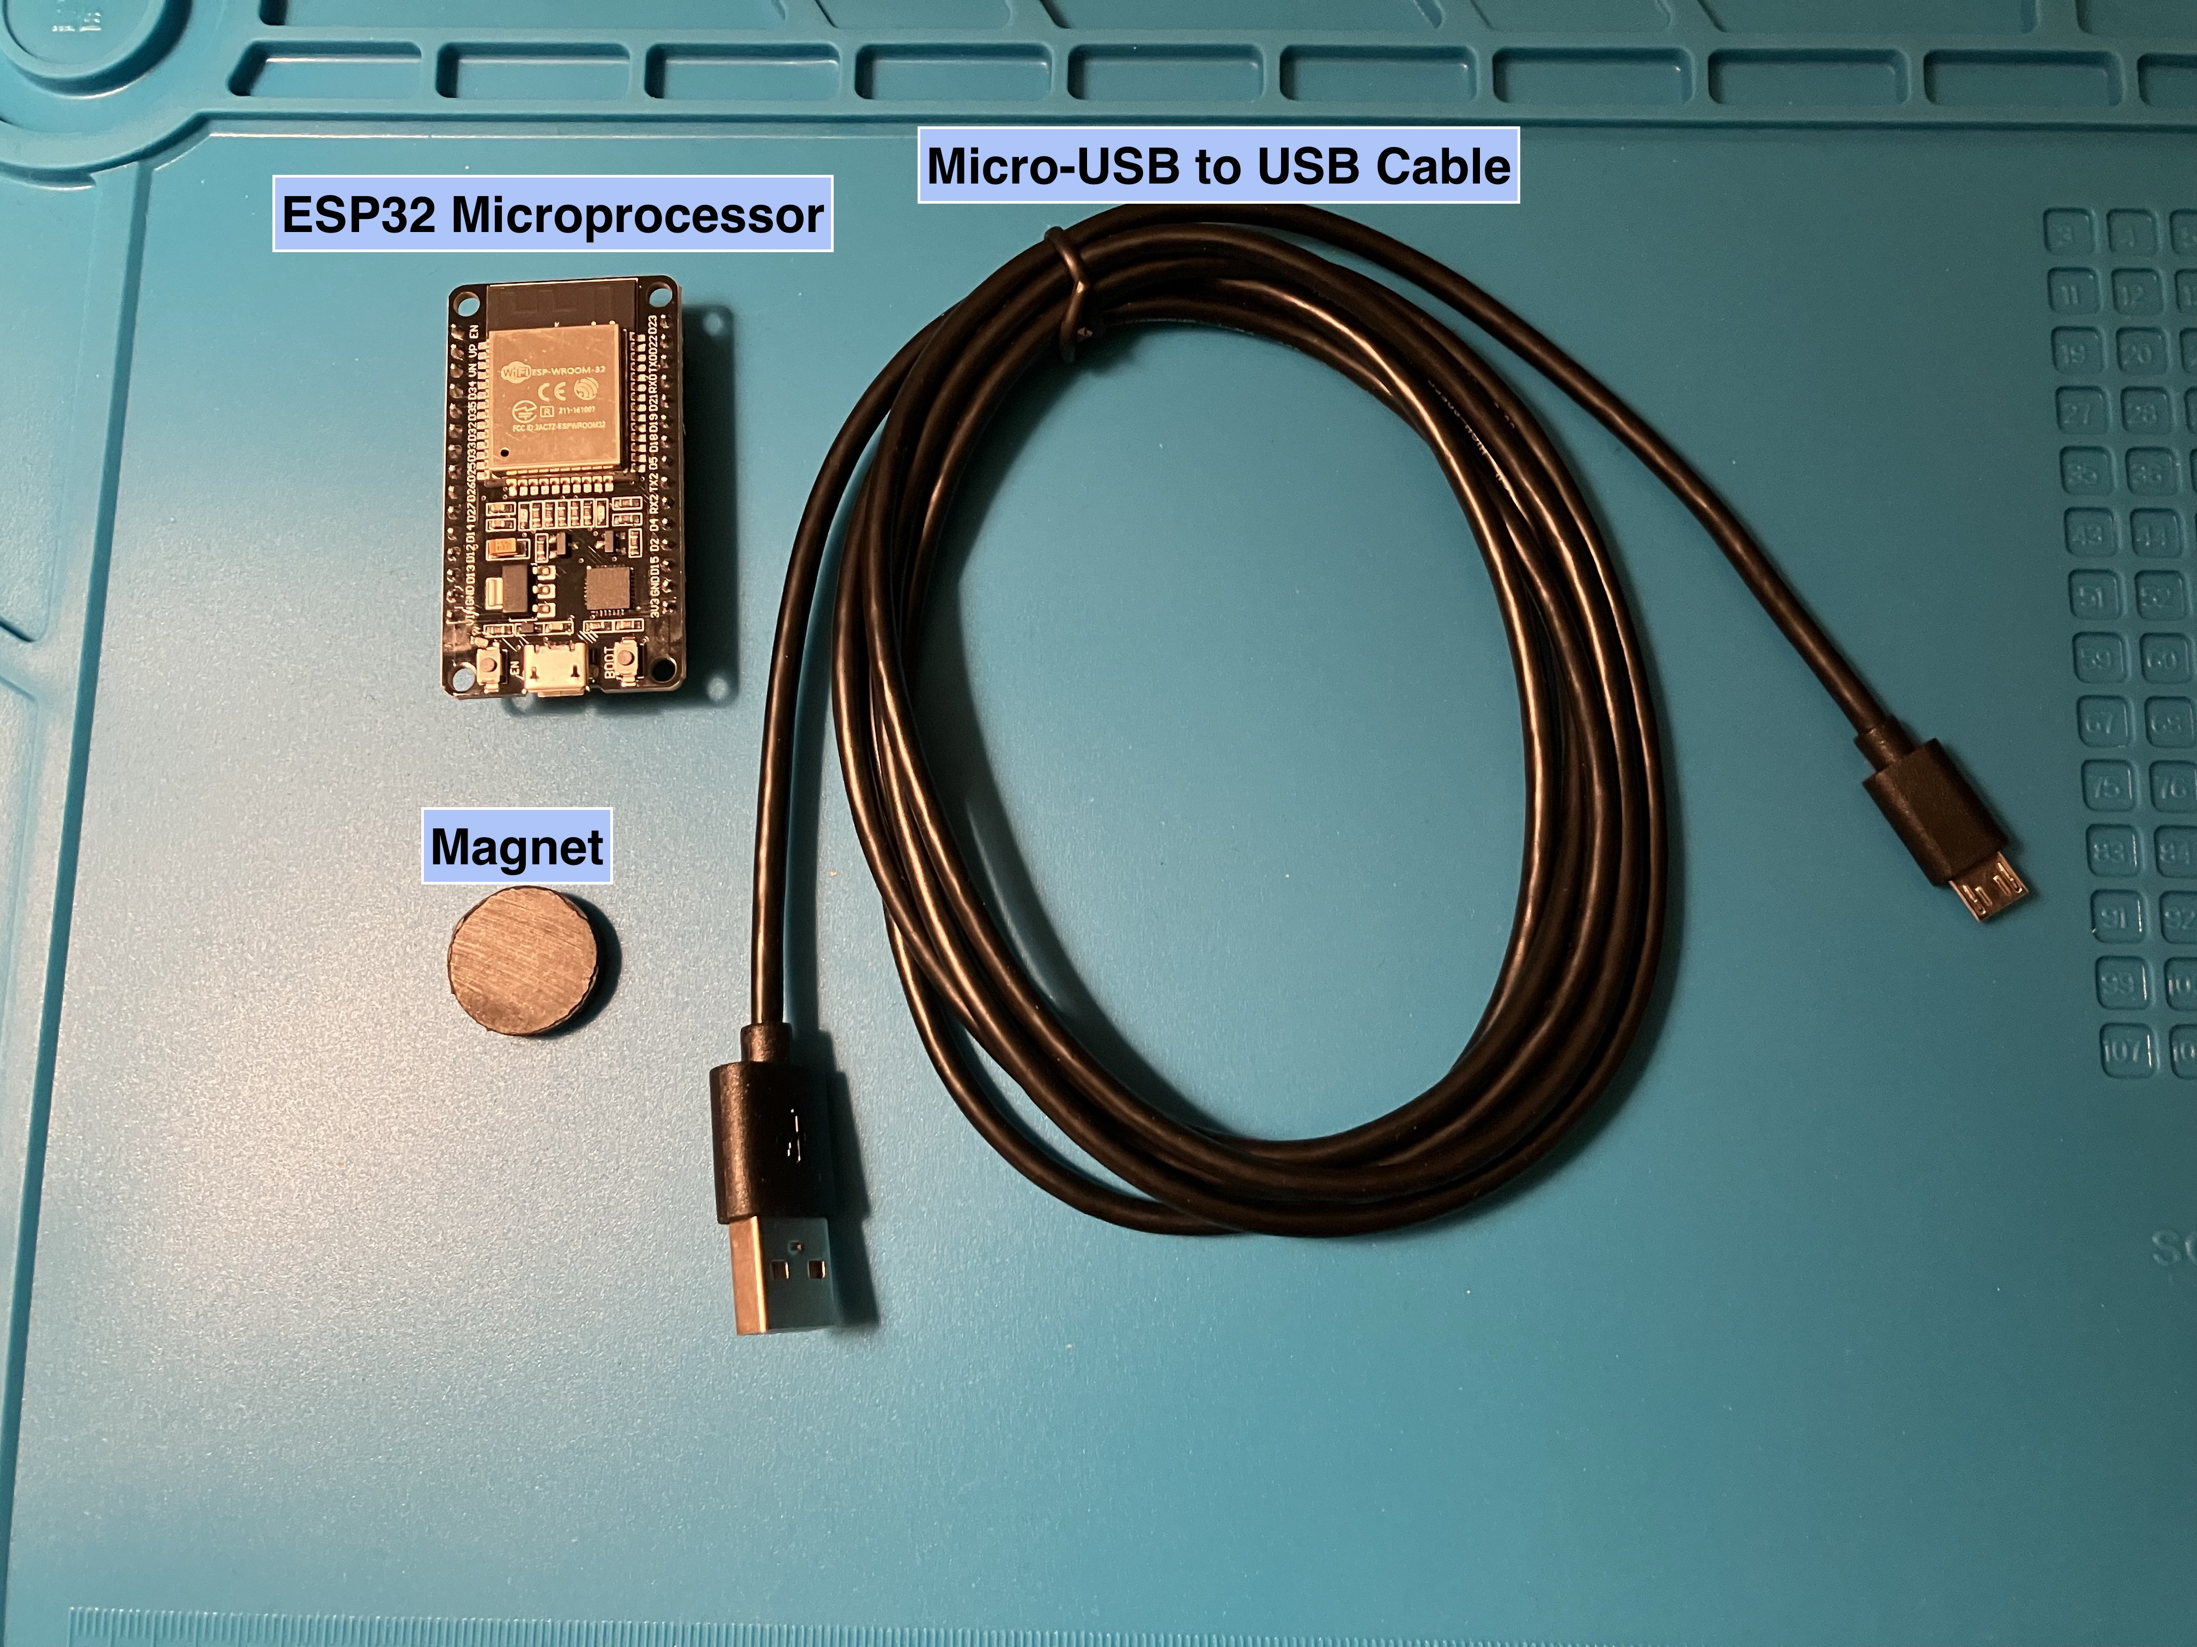
Section 1: Materials Used

Slide 8
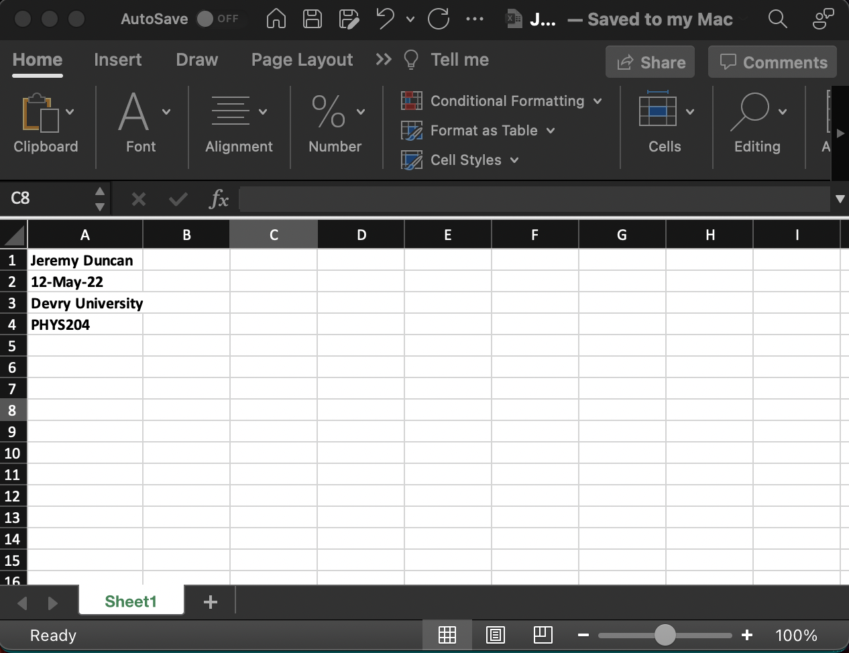
Section 1: Materials Used
Microsoft Excel

Slide 9
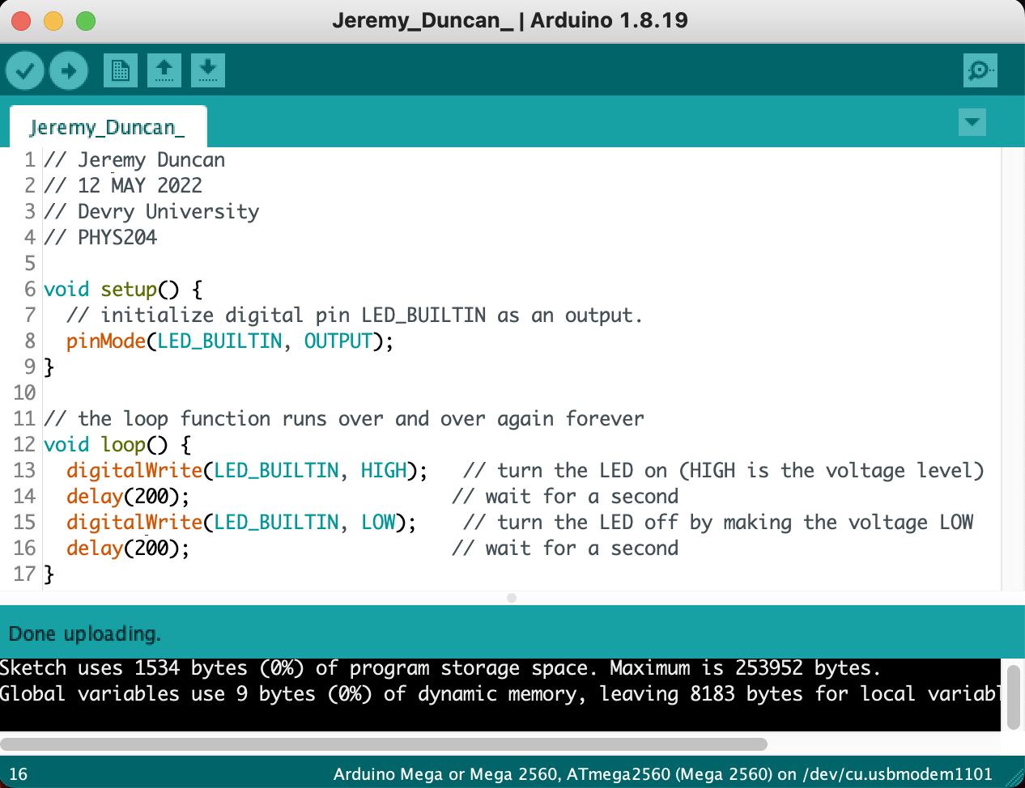
Section 1: Materials Used
Arduino IDE

Slide 10
SECTION 2
Precision of Ultrasonic Sensor
In section Two of my project, I:
Demonstrate the accuracy of the ultrasonic sensor at measuring distance.

Slide 11
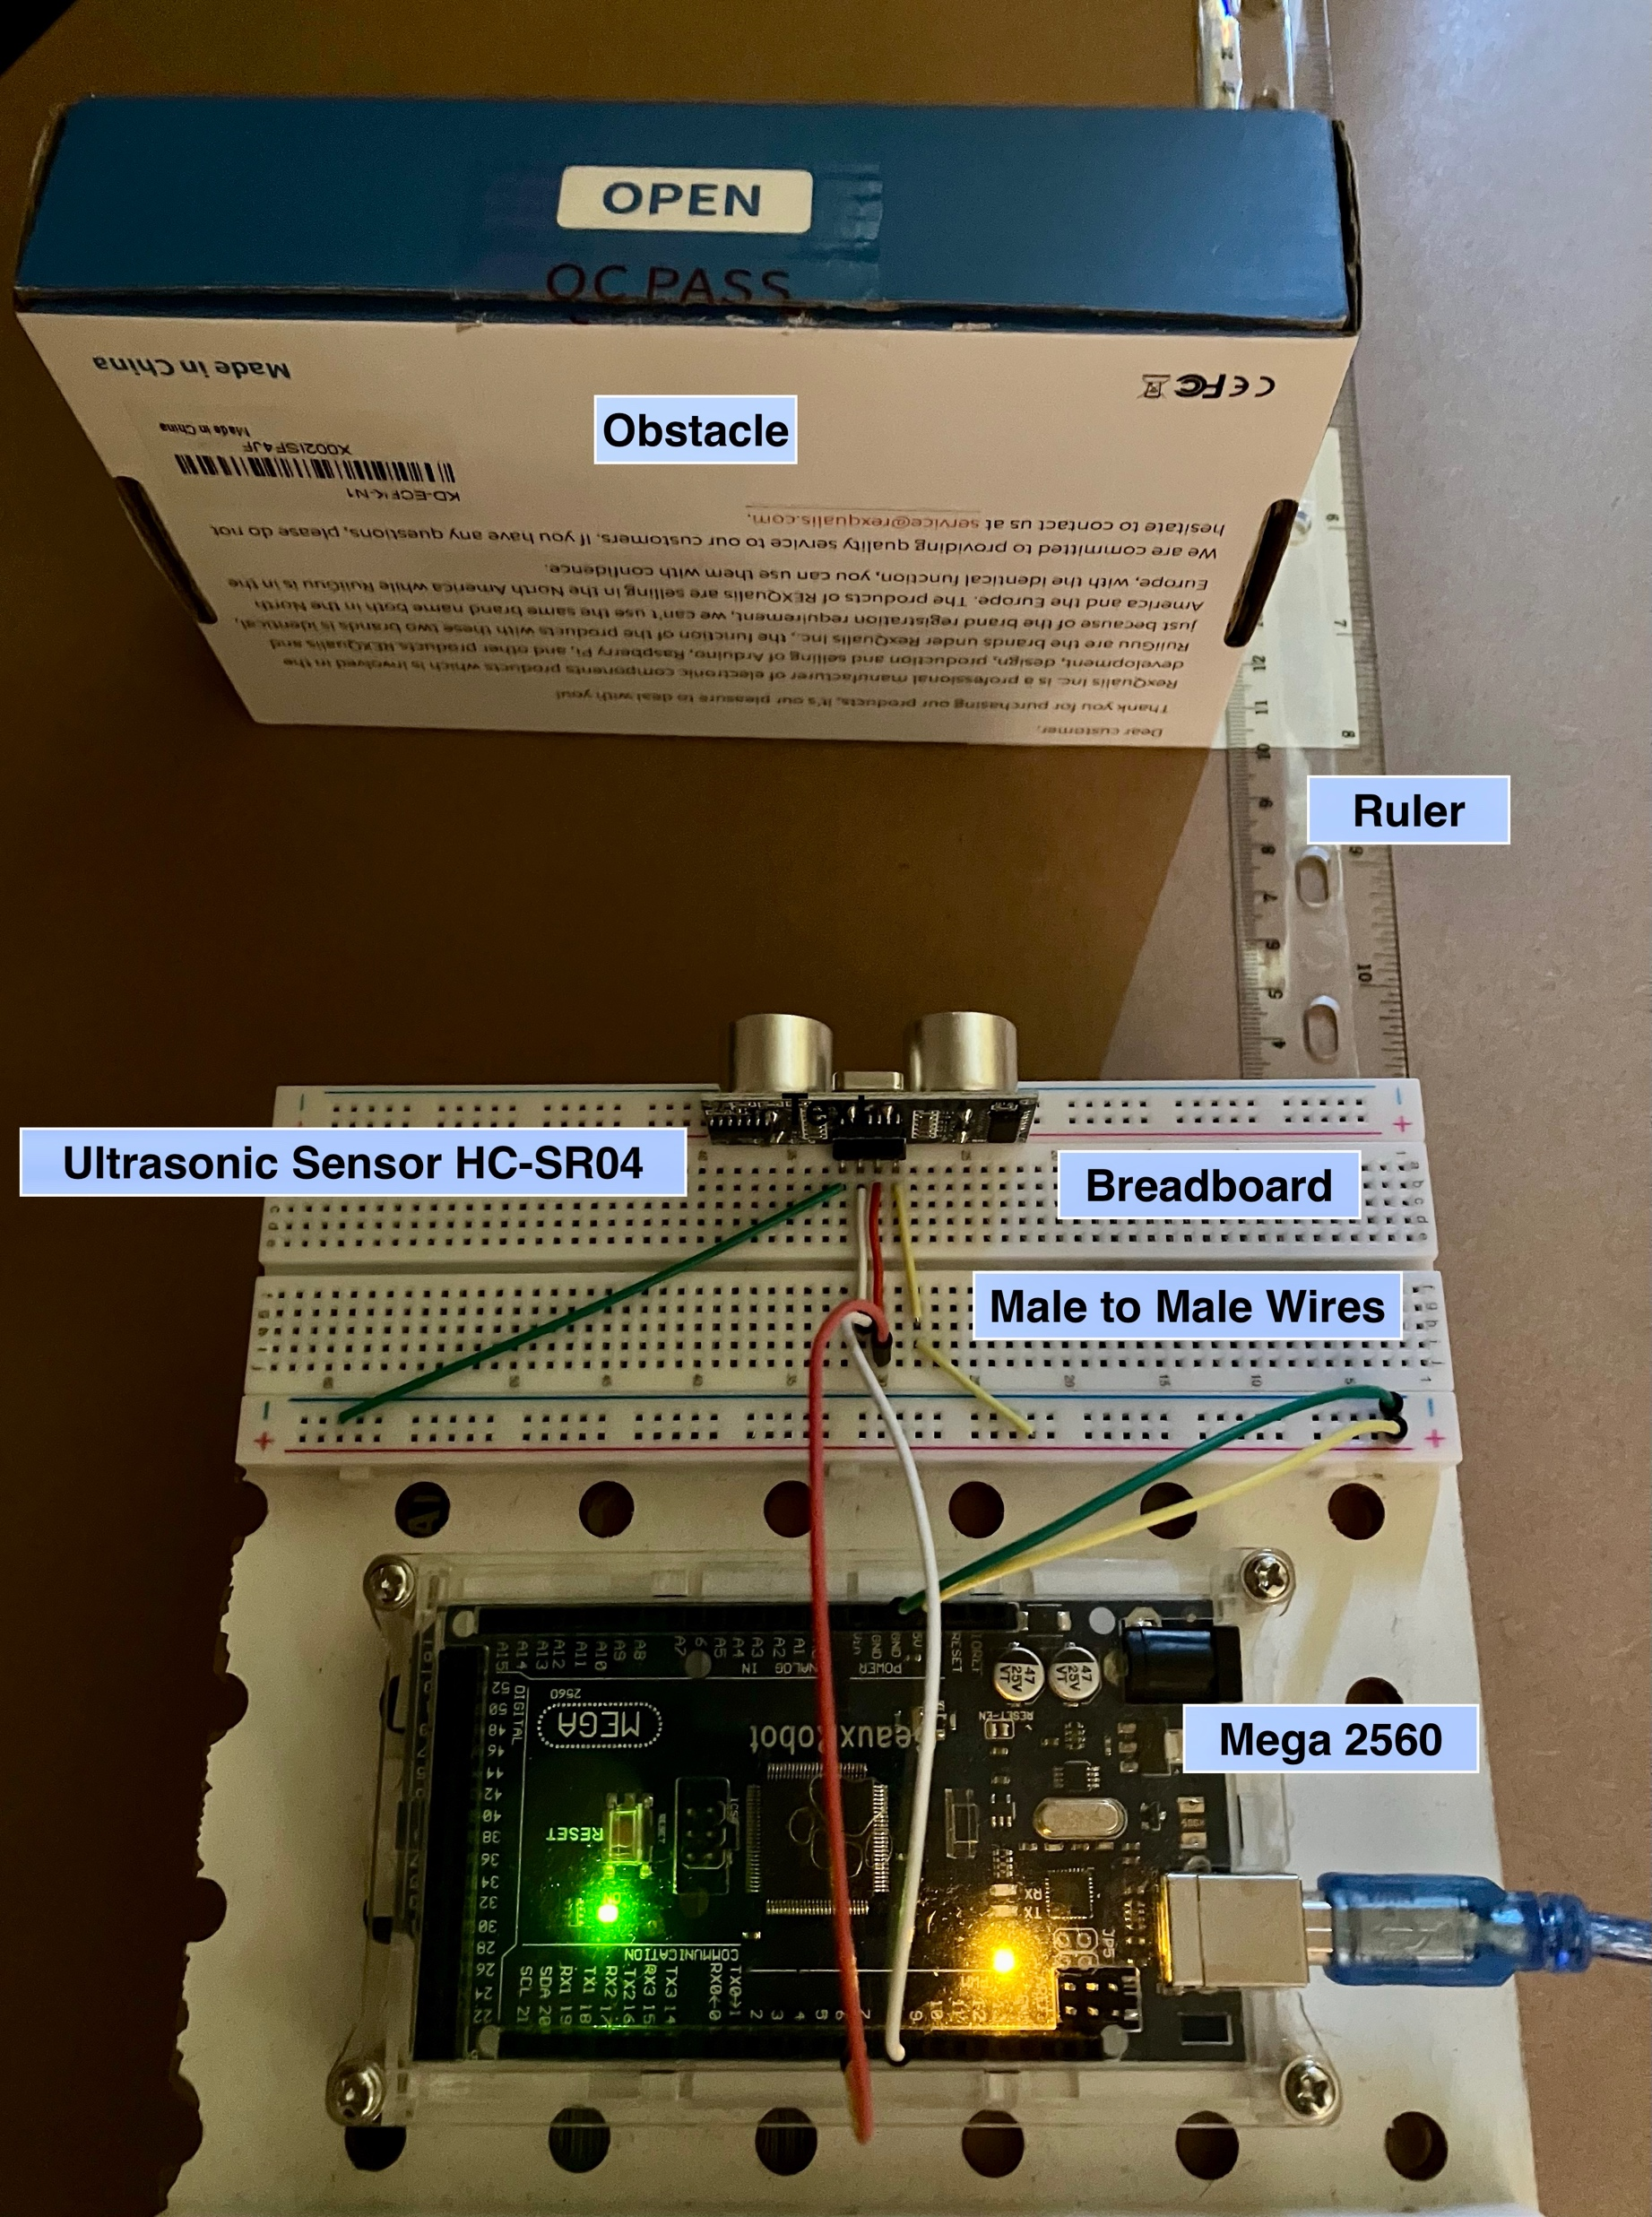
Section 2: Precision of Ultrasonic Sensor
Experiment Set-up
In this experiment I am testing the accuracy of the ultrasonic sensor.
This is accomplished by comparing the time it takes for the Arduino to register that the sound waves bounced back from a known distance and comparing that with the known standard (speed of sound).

Slide 12
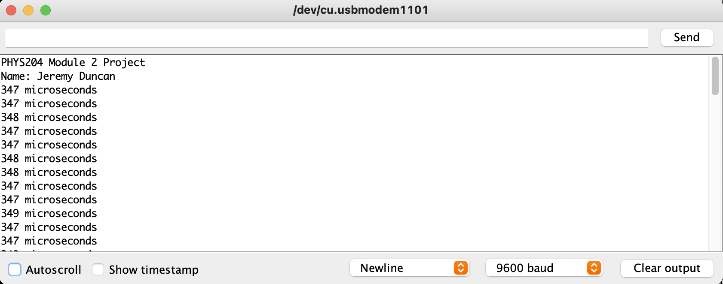
Section 2: Precision of Ultrasonic Sensor
The Arduino serial monitor is showing the time it takes for the sound waves to bounce back.

Slide 13
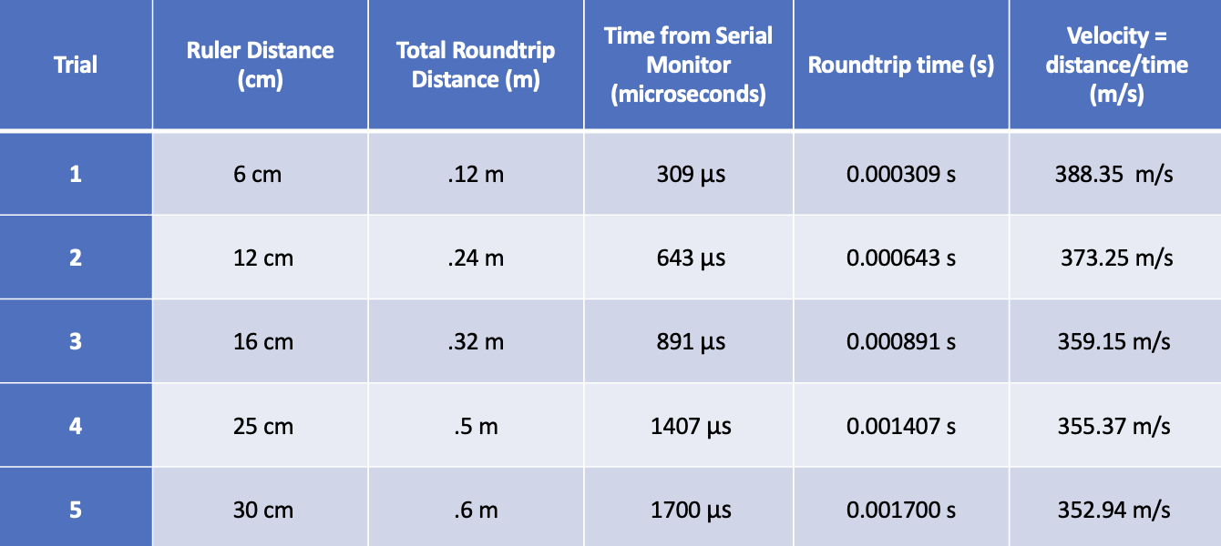
Section 2: Precision of Ultrasonic Sensor
This is the data generated from each trial of the experiment.

Slide 14
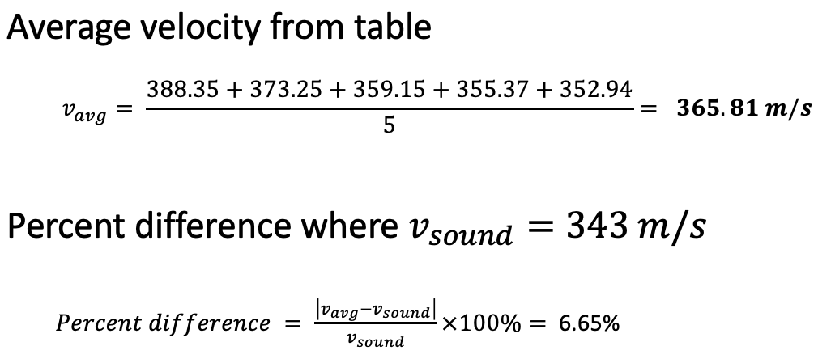
Section 2: Precision of Ultrasonic Sensor
The data is then analyzed by averaging out all the trials and finding the margin of error.

Slide 15
Conclusions
Section 2: Precision of Ultrasonic Sensor
The source of errors can be from a variety of factors to include humidity, temperature, and electrical component margin of error with the Arduino and Ultra-Sonic sensor.
Temperature and humidity have a direct correlation to the speed of sound. As they increase, so does the speed of sound.
Pressure does not have an affect on the speed of sound.

Slide 16
SECTION 3
Gravitational Acceleration
In section Three of my project, I:
Demonstrate Gravitational Acceleration while using the ultrasonic sensor.

Slide 17
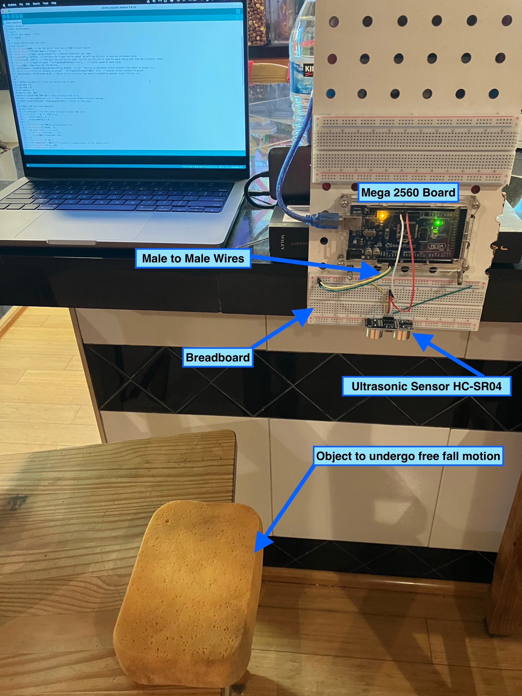
Section 3: Gravitational Acceleration
Experiment Set-up
In this experiment I will be dropping a sponge underneath the ultrasonic sensor to measure the speed of descent.
I can then analyze this data to determine gravitational acceleration.

Slide 18
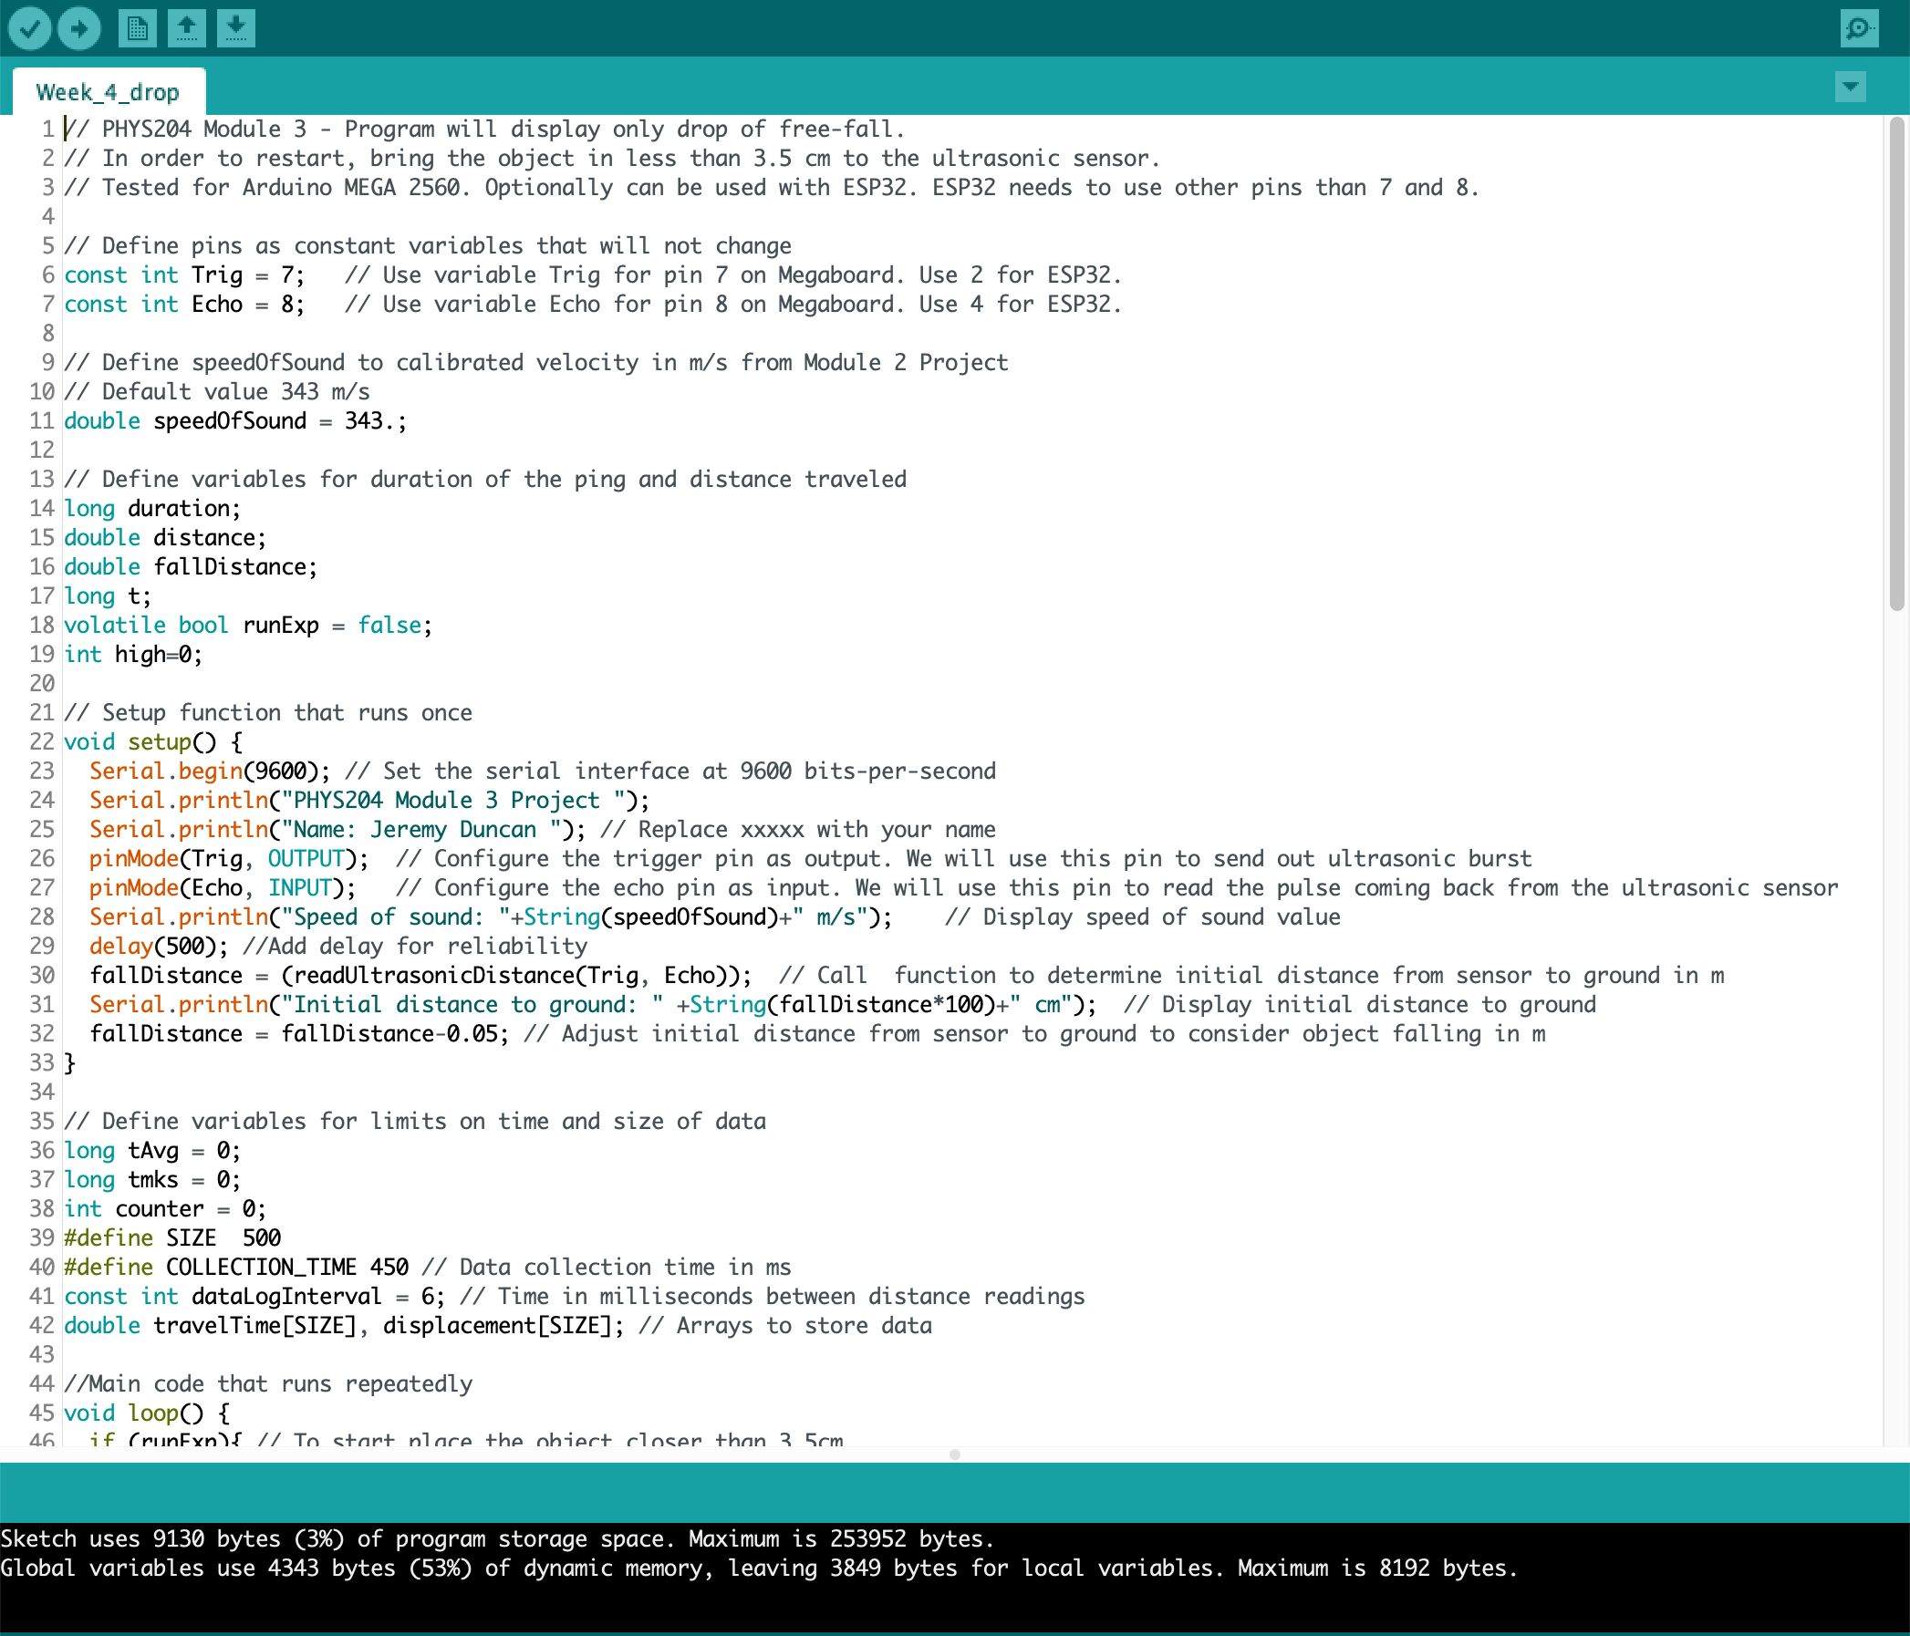
Section 3: Gravitational Acceleration
Code used for experiment

Slide 19
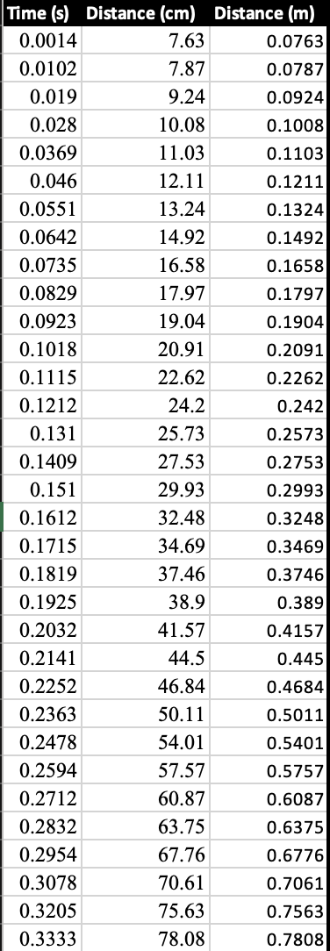
Section 3: Gravitational Acceleration
Raw Data Collected From Arduino Serial Monitor.

Slide 20
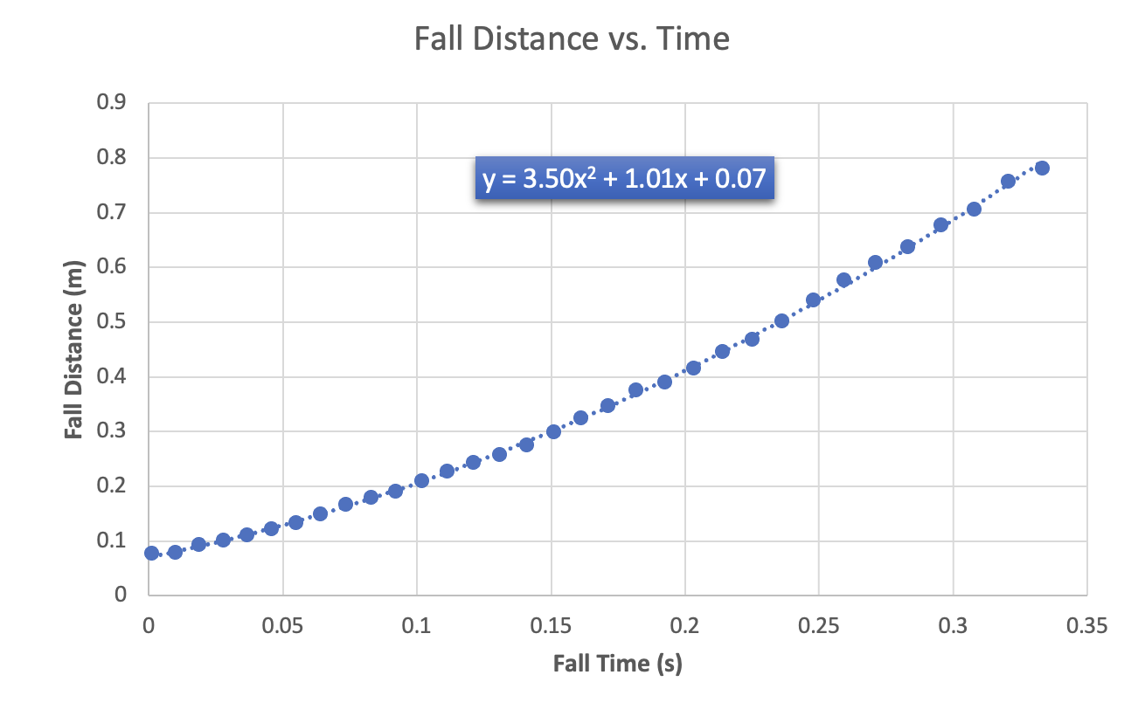
Section 3: Gravitational Acceleration
Visual display of drop data.

Slide 21
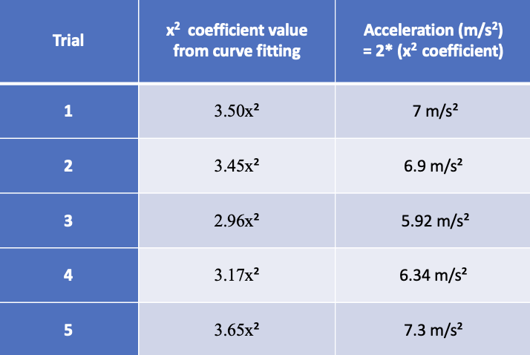
Section 3: Gravitational Acceleration
The values from each trial I conducted.

Slide 22
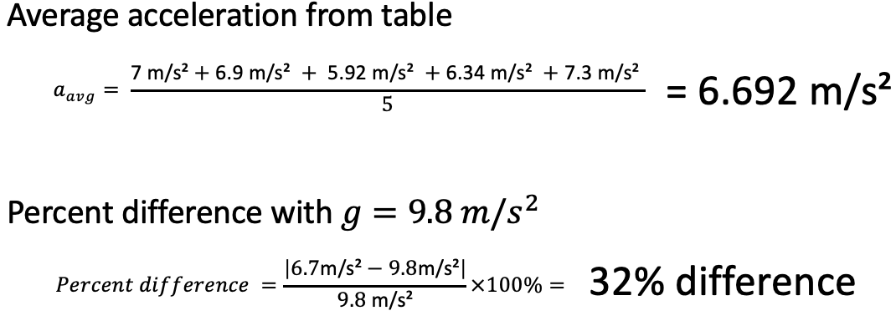
Section 3: Gravitational Acceleration
The data is then analyzed by averaging out all the trials and finding the margin of error.

Slide 23
Conclusions
Section 3: Gravitational Acceleration
It seems there was about a 32% difference between actual experiment results and the acceleration due to gravity. Since my object was a sponge, I believe this can be attributed to a combination of factors such as electrical component accuracy and air resistance. I noticed the measured distance from the floor was not consistent as well each time I initialized the program. Another interesting observation was that the Ultrasonic sensor did not detect the sponge at all initially. I determined that the sponge was not reflecting the sound waves and instead absorbing them. I resolved this issue by wrapping the sponge with paper to allow the sound to reflect.
There were slight variations in each trial, but all numbers were consistent curves with no major outliers.

Slide 24
SECTION 4
Conservation Of Energy
In section Four of my project, I am:
Demonstrating Conservation Of Energy by using the data I obtained from my gravitational acceleration experiment.

Slide 25
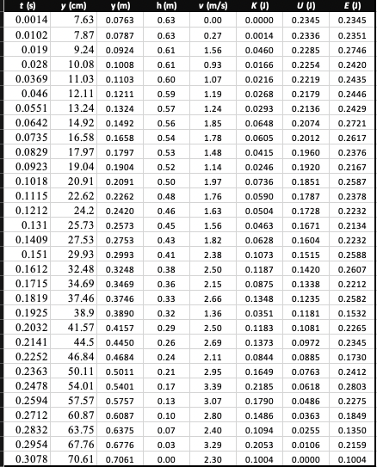
Section 4: Conservation Of Energy
Raw Data Collected from Ultrasonic Sensor.

Slide 26
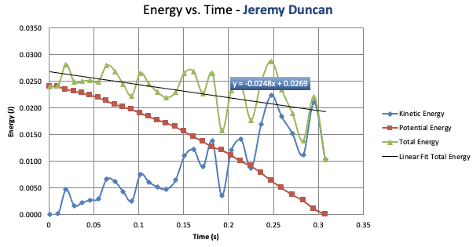
Section 4: Conservation Of Energy
You can easily see the transfer of energy from one state to another by looking at this graph.

Slide 27
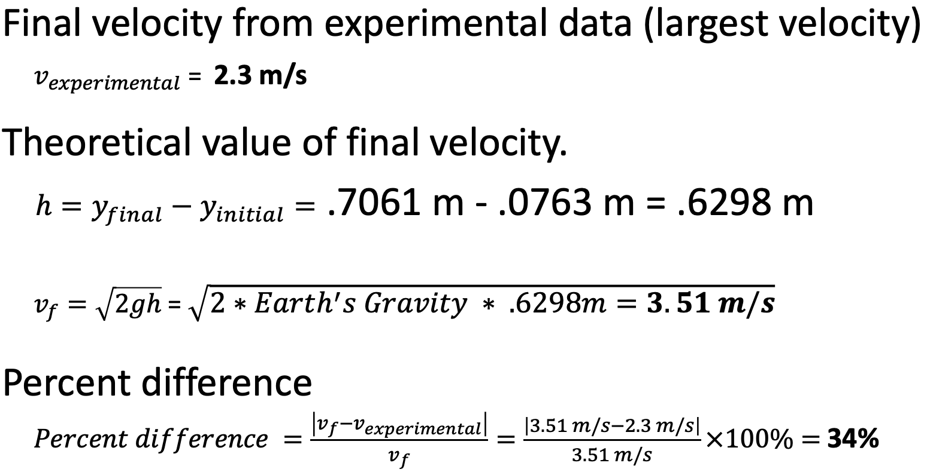
Section 4: Conservation Of Energy
The data is then analyzed by averaging out all the trials and finding the margin of error.

Slide 28
Conclusions
Section 4: Conservation Of Energy
When U (Potential Energy) is at Max, K (Kinetic Energy) is at it’s Min. They are inverse from each other. As one goes down, the other goes up.
U and K are around the same value about halfway through the measured drop.
This shows that there is a transfer of energy from Potential energy to Kinetic energy.
The trend of the total energy line seems to be proportional to K (Kinetic Energy)with Its peaks and valleys until the object ultimately stops at the floor.
The mechanical energy is decreasing slightly due to air resistance.

Slide 29
SECTION 5
Rotational Motion
In section Four of my project, I:
convert radial displacement to linear displacement using the rotary encoder.

Slide 30
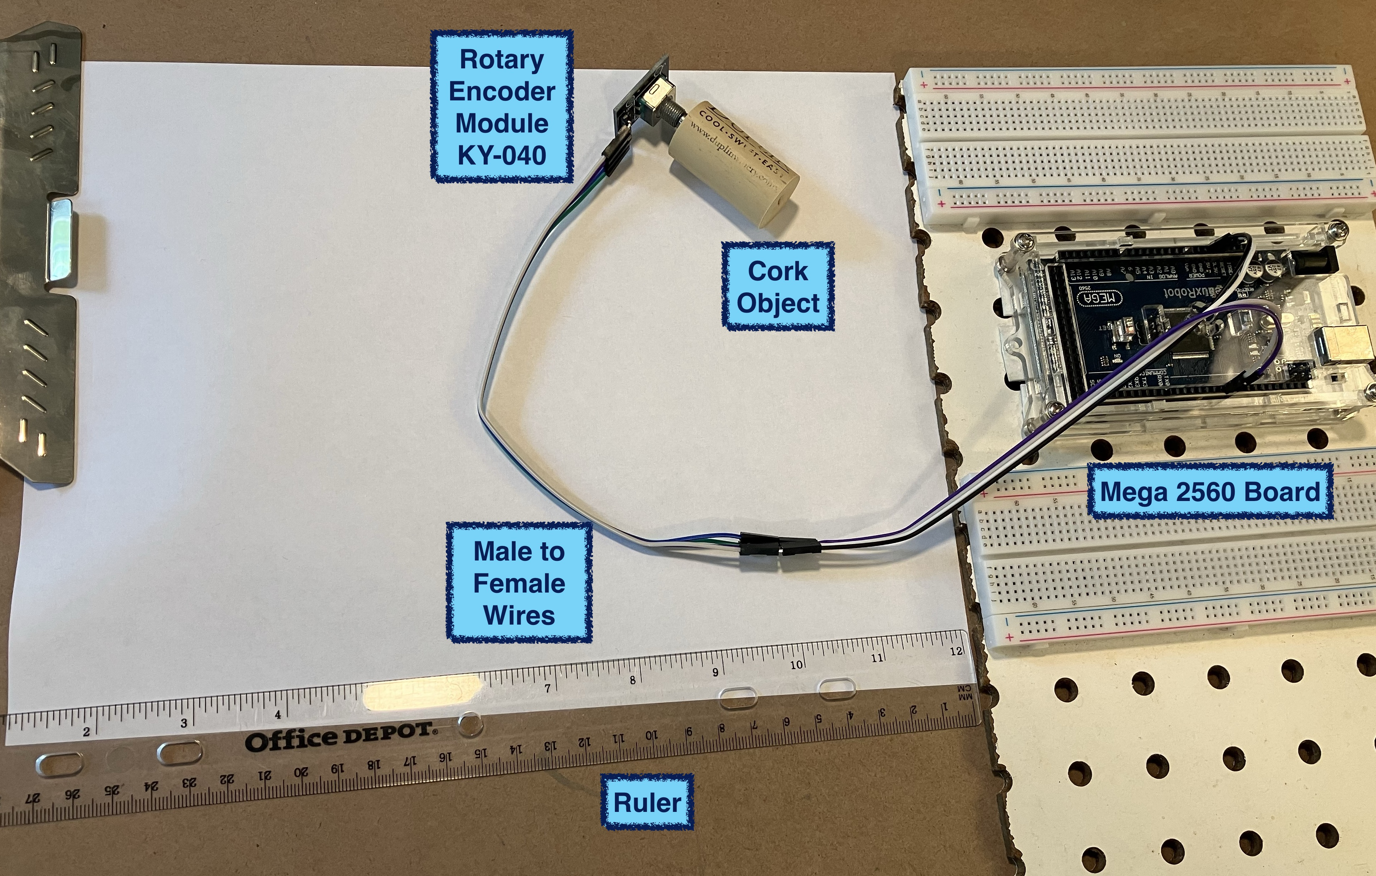
Section 5: Rotational Motion
In this experiment I will be testing that radial displacement can be used to measure linear displacement with the rotary encoder.
Experiment Set-up

Slide 31
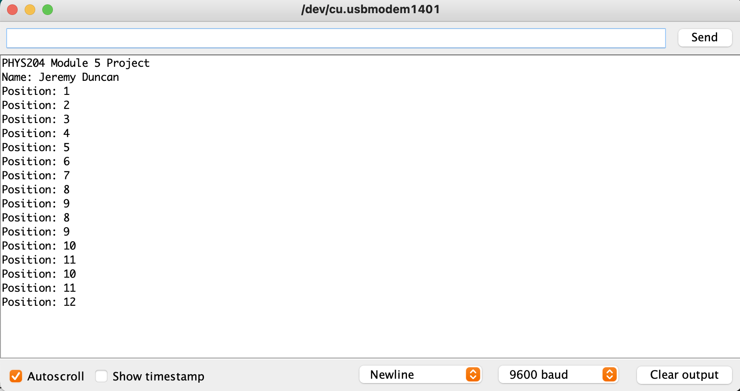
Section 5: Rotational Motion
Raw data from Arduino serial monitor when the rotary dial moves.

Slide 32
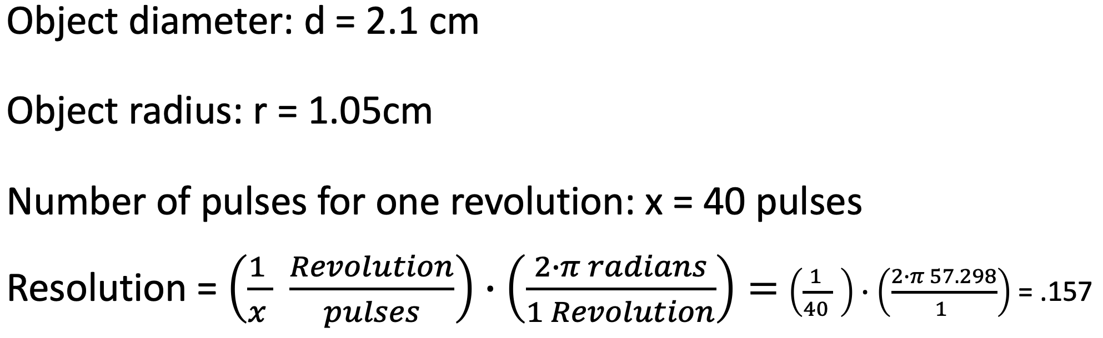
Section 5: Rotational Motion
It took 40 pulses from the rotary dial to equal 1 revolution.
Based on that information and the radius of my object I am rotating I can figure out the resolution.

Slide 33
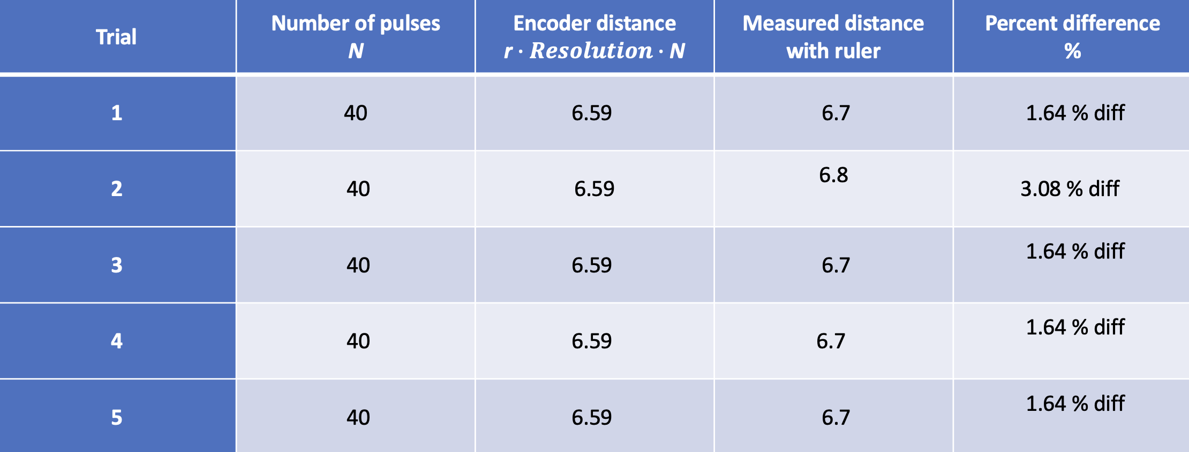
Section 5: Rotational Motion
The data is then analyzed by averaging out all the trials and finding the margin of error.

Slide 34
Conclusions
Section 5: Rotational Motion
All things considered; the results were fairly accurate. I believe the margin of error can be contributed to human error which could be a result of marking start and stop distances traveled with a round cork.
One application I can think this could be used for would be measuring distance on uneven terrain such as hills. I could also see this being applied in industrial applications where non-flat surfaces need to be measured.

Slide 35
SECTION 6
Hall Effect
In section Five of my project, I:
investigate the hall effect by using the ESP32 microprocessor to measure the proportional voltage under the effect of a magnetic field .

Slide 36
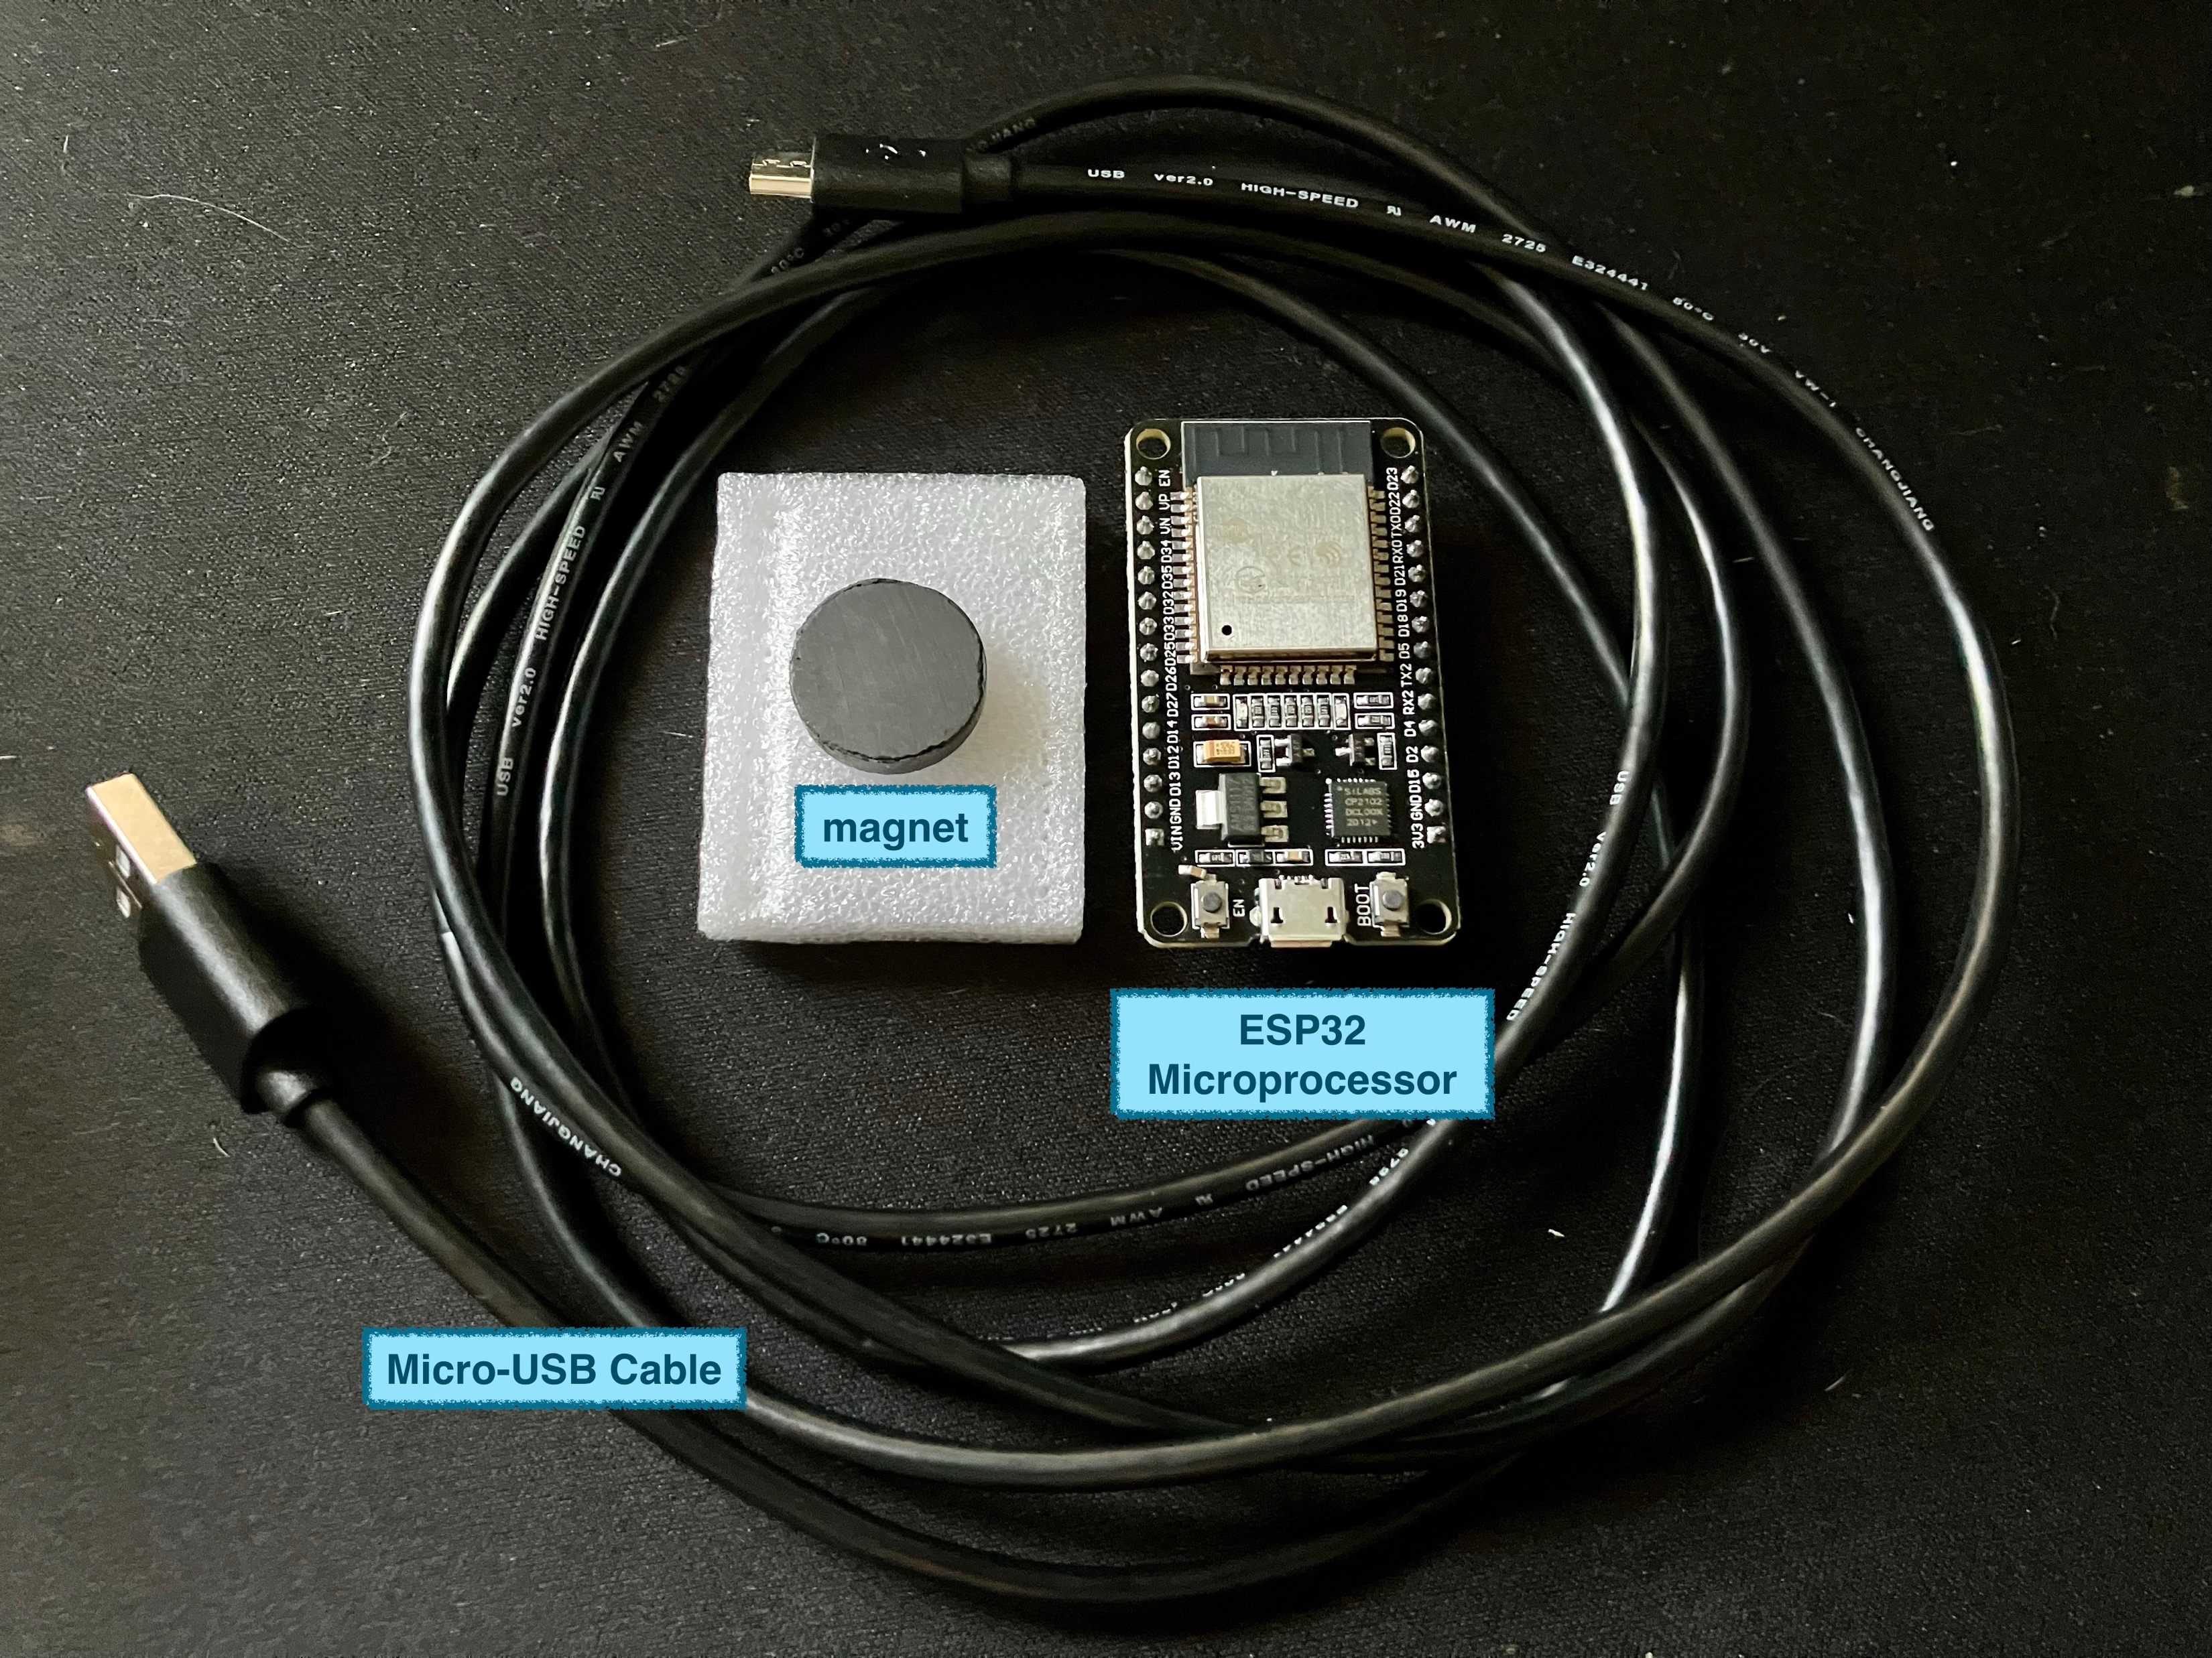
Section 6: Hall Effect
In this experiment I will use a small magnet to test and see if the ESP32 can detect magnetic waves
Experiment Set-up

Slide 37
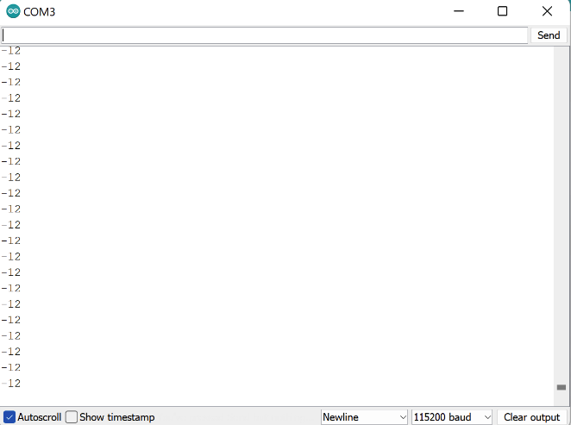
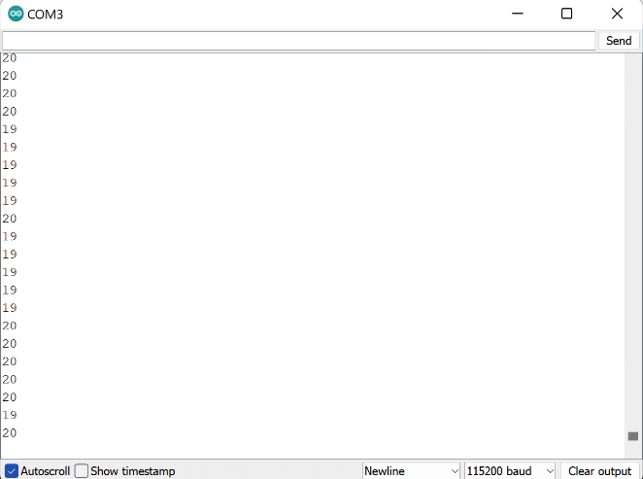
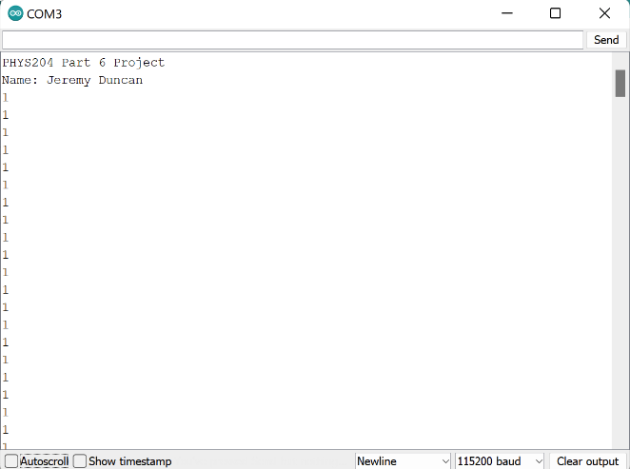
Section 6: Hall Effect
Raw Data From Arduino Serial Console
Magnet-
Magnet+
Baseline

Slide 38
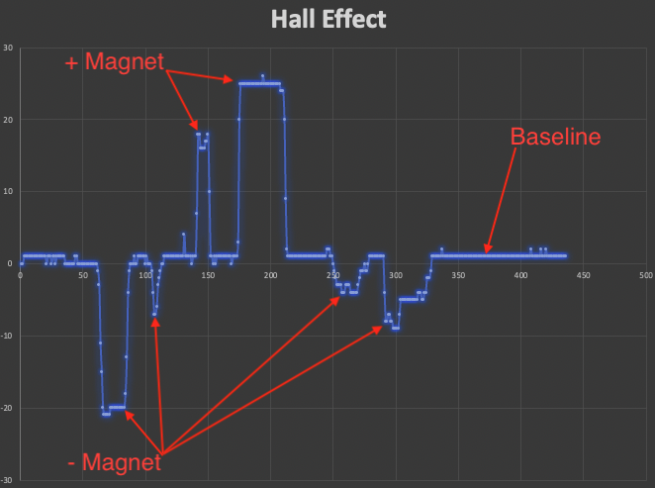
Section 6: Hall Effect
You can see when I put the positive or negative side of the magnet near the esp32

Slide 39
Conclusions
Section 6: Hall Effect
You can see a correlation between when the positive or negative side of the magnet comes close to the Hall Sensor on the ESP32. The sensor works by detecting variation the in the magnetic field and outputting a voltage based on the magnitude of the magnetic field.
I can see this being used for applications such as engaging a switch, proximity detection, and detecting if a doors close.

Slide 40
Project Challenges
One of the challenges I faced was during the free fall experiment when I tried to use the sponge with the ultrasonic sensor.
The ultrasonic sensor was not showing data on the sponge falling, and I realized that was because it was absorbing the ultrasonic frequencies.
I solved this problem by wrapping the sponge in paper to allow the sound waves to bounce back to the sensor.

Slide 41
Career Skills obtained
Analyzing raw data for useful applications
Critical Thinking
Experience utilizing IoT devices to solve complex problems
Programming experience with Arduino
Programming experience with esp32

Slide 42
Conclusion
While completing this project, I have learned the importance of IoT devices, and I have gained a better understanding of the laws of physics that govern our natural world.

Slide 43
REFERENCES
https://www.arduino.cc/
https://store.arduino.cc/products/arduino-mega-2560-rev3
https://www.espressif.com/en/products/socs/esp32

